Slide 1
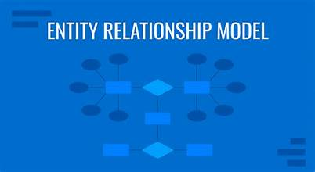
THE E-R MODEL
Understanding the Entity-Relationship (ER) Model
BS-CS-II

Slide 2
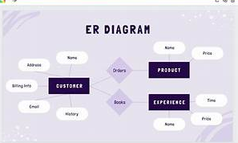
Introduction of ER model
Definition:
The Entity-Relationship (ER) Model is a conceptual framework used to represent the data and its relationships within a database system.
It is simple and clear.
It is a graphical representation.

Slide 3
Basic Components
Entity
*Attribute
* Relationships

Slide 4
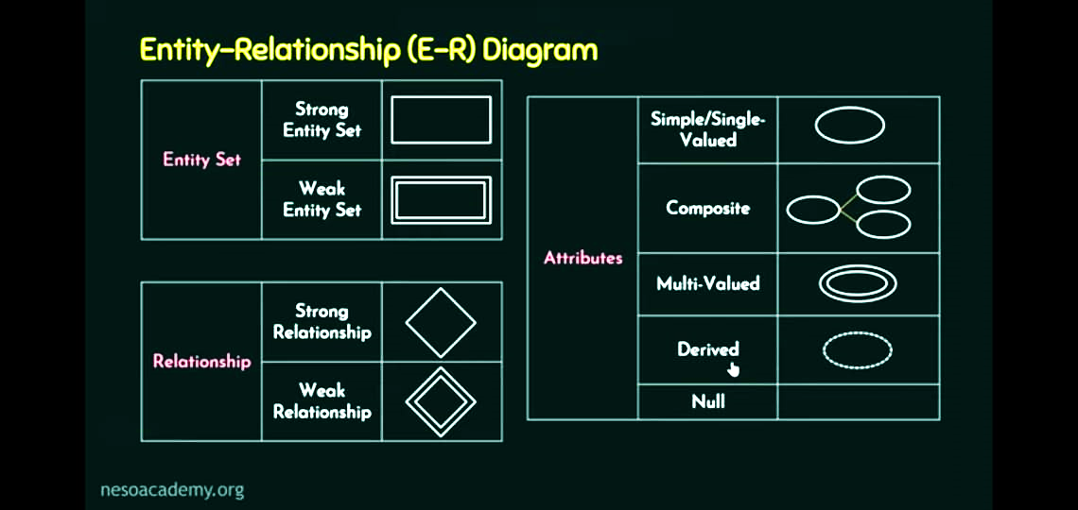
Basic Components
Entity set:
Objects or concepts that have an independent existence and can be described with attributes (Represented by rectangle).
Exp: customer, product.
* Key attribute:
The attribute that is capable of identifying each entity uniquely.
Exp: roll no of student.
Relationships
Connections between entities. (Represented by Diamond) .

Slide 5
Basic Components
Attributes:
Properties or details that describe entities. (Represented by oval) .
Single/Simple/Stored attribute:
Have a single value for a particular entity.
Exp: age.

Slide 6
Basic Components
Multivalued attribute:
Can have set of values for a particular entity
Exp: Degree, language, skill.
Derived attribute:
Can be derived from another attribute.
Exp: Age can be derived from date of birth.

Slide 7
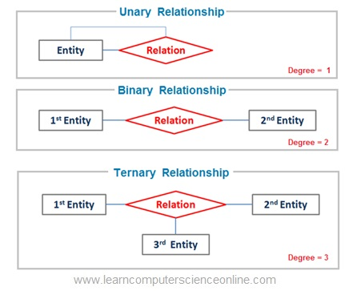
RELATIONS
Unary relation:
A relationship between same entity type.
Example: Employ manages another Employ.
Binary relation:
A relationship between two different entity types.
Example: Author writes Book

Slide 8
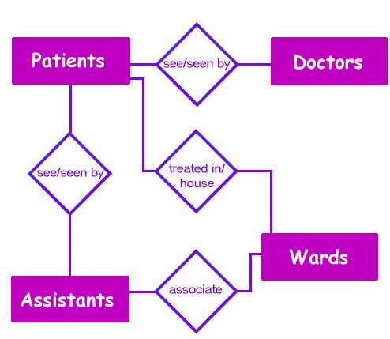
RELATIONS
Ternary relation:
A relationship between three entity types.
Example: Student borrows a Book from a Library
Quardinary Relation:
A relationship between four different entity types.
Example: Student Course Semester Instructor in a university shadule.

Slide 9
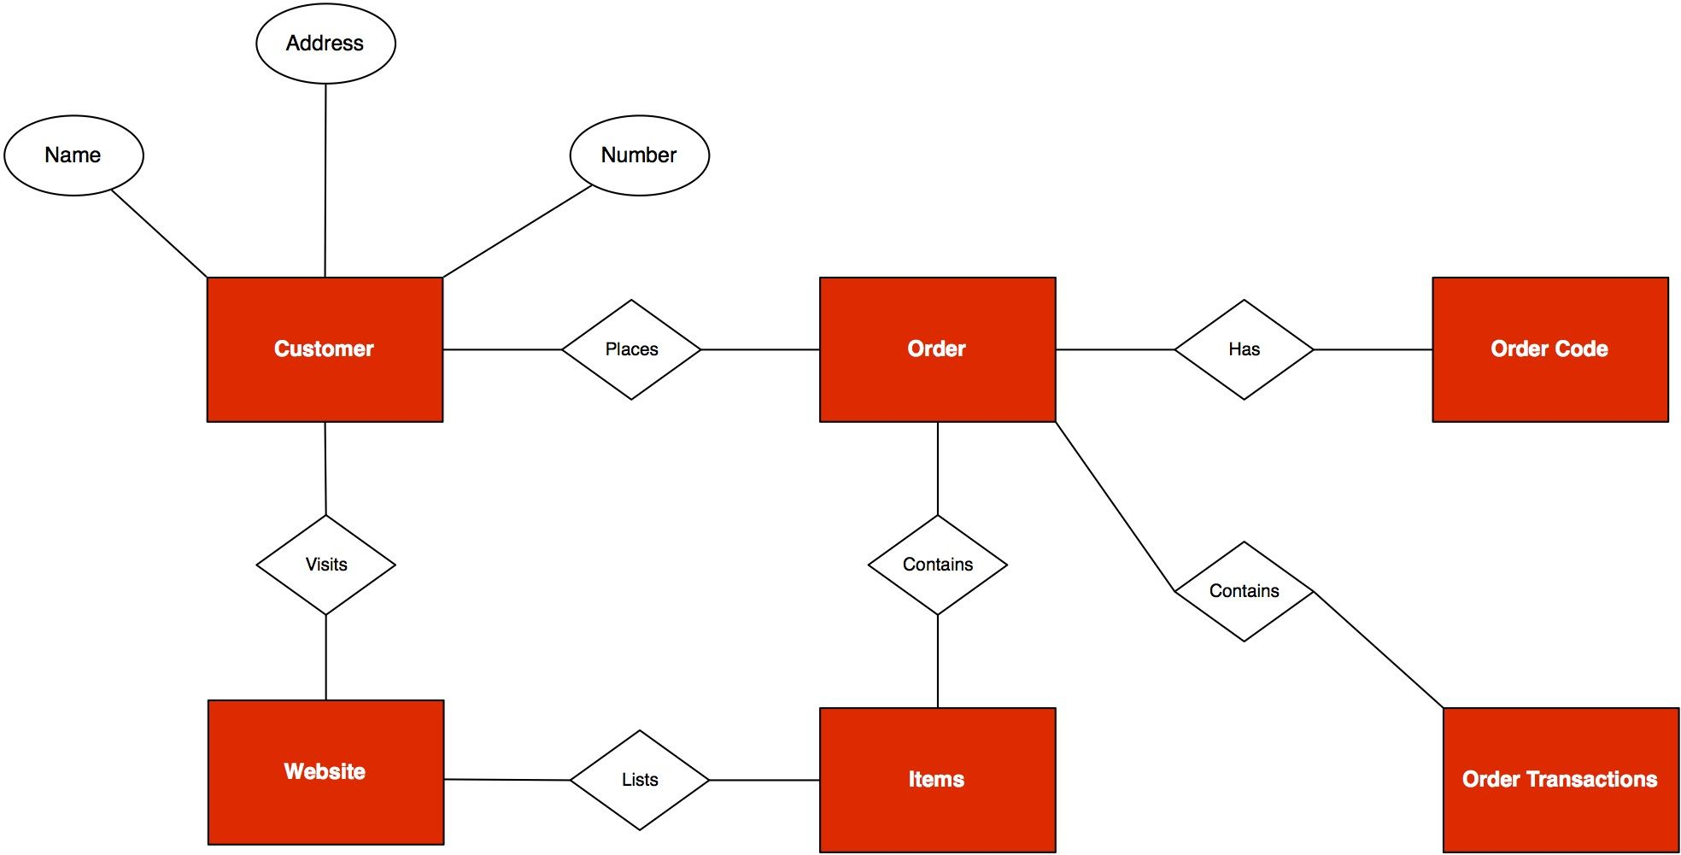
RELATIONS
N-ary Relationship:
A relationship involving more than 4 entities.

Slide 10
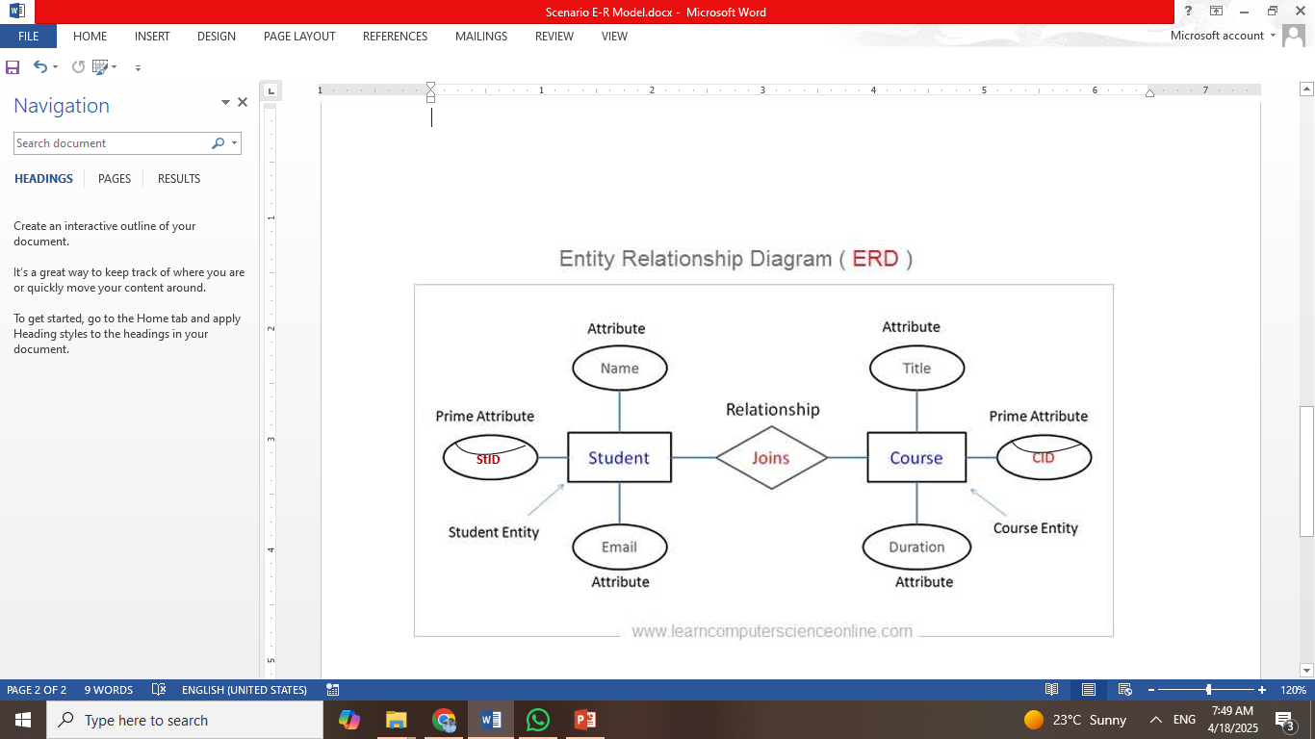
Real Life Scenario

Slide 11
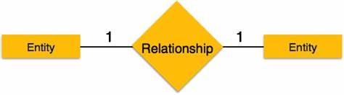
Cardinality Ratios:
Specifies the number of relations between entities.
One-to-One (1:1): The relationship between two entities.
A customer has one address (1:1).

Slide 12
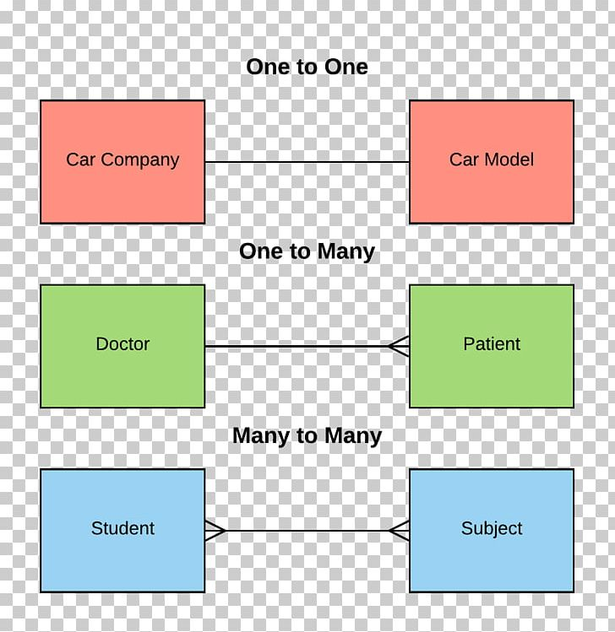
Cardinality Ratios:
One-to-Many (1:N): The relationship of one entity with many entities.
A department has many employees (1:N).
Many-to-Many (N:N): The relationship of many entities with many entities.
A student can enroll in many courses, and a course can have many students (N:N).
1
N
N
N

Slide 13
Importance and Applications of Database Design
Database Design:
Serves as a blueprint for creating relational databases.
Data Modeling:
Helps in visualizing data structures and their interrelationships.

Slide 14
Applications:
Designing academic systems (e.g., university databases)
Developing business applications (e.g., inventory management systems)
Creating information systems for various domains

Slide 15
THANK YOU

